Slide 1
Creating and Managing User Accounts
Version A.01
H3064S Module 3 Slides

Slide 2
Users and Groups — Access to System and Data
Sue
Jim
Frank
Users
Sales
Jean
Sue
Ann
Marie
Bob
Frank
Develop
a538350

Slide 3
What Defines a User Account?
/etc/passwd
user1: . . .
user2: . . .
user3: . . .
user4: . . .
/etc/group
accounts: . . .
research: . . .
finances: . . .
admin: . . .
/home
user1
user2
a6695

Slide 4
The /etc/passwd File
Example:
root:mAj8as.,8as.,ofads:0:3::/:/bin/sh
daemon:*:1:5::/:/sbin/sh
date:r.c7.0x4/,hGJ:20:1::/:/usr/bin/date
erik:.r.ca8/,f2i5y:204:20::/home/erik:/usr/bin/sh
Use
/usr/sbin/vipw
to edit
Use
/usr/sbin/pwck
terry:ZMPPAvHrXTDfM:265:20:Terry Kellog:/home/terry:/usr/bin/sh
username
user ID
group ID
home directory
login shell
encrypted password
ID string
a6971

Slide 5
The /etc/group File
group_name:password:group_id:group_list
Example:
other::1:root,daemon,uucp,sync
users::20:
develop::101:bugs,daffy
sales::102:bugs,daffy,elmer,marvin
Use /usr/sbin/grpck to check.
a538353

Slide 6
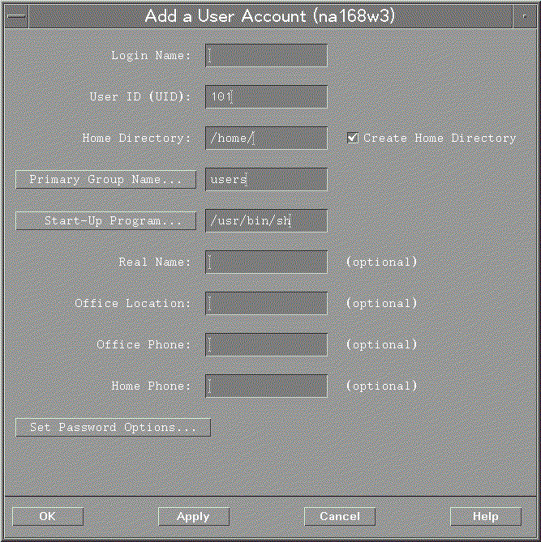
Creating User Accounts with SAM
a6696

Slide 7
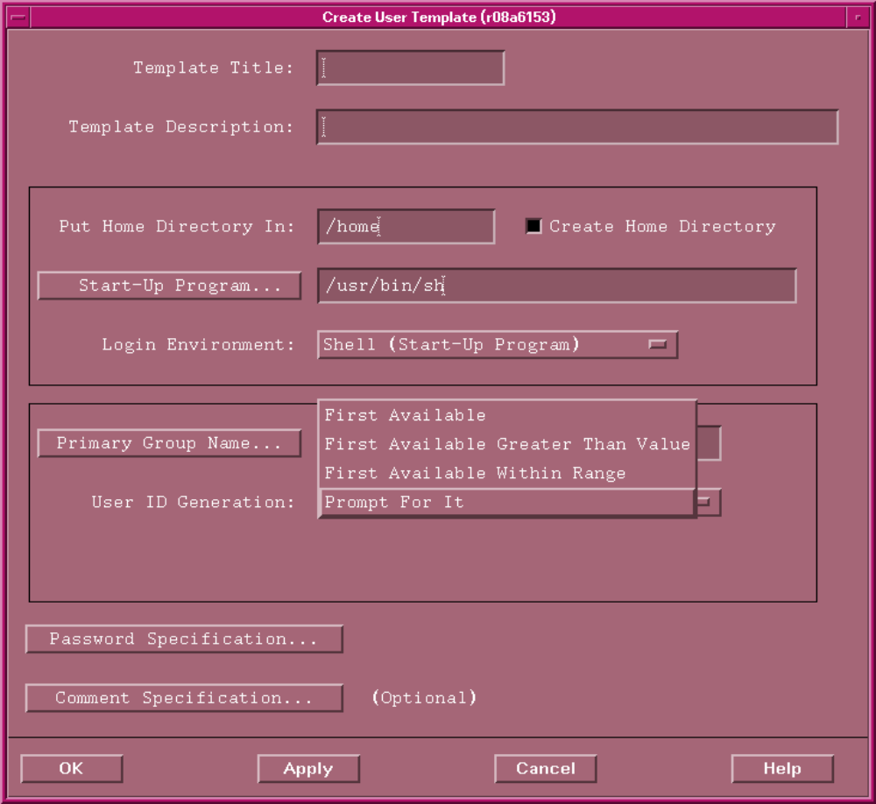
Creating User Templates in SAM
a669145

Slide 8
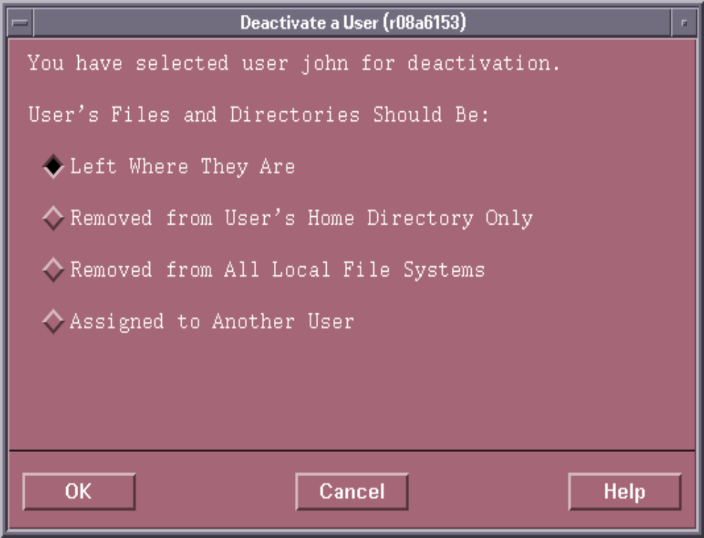
Deactivating and Removing Users with SAM
a6697

Slide 9
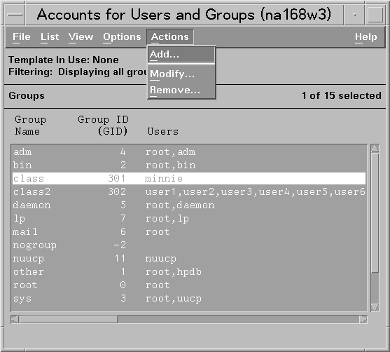
Managing Group Membership with SAM
a6699

Slide 10
Managing User Accounts from the Command Line
useradd, usermod, userdel
groupadd, groupmod, groupdel
a66910

Slide 11
Changing User Passwords from the Command Line
$ passwd Users can change their own password
(must know current password)
Changing password for bugs
Old password:
New password:
Re-enter new password:
$
# passwd bugs Root can change any user's password
New password:
Re-enter new password:
#
# passwd Root can change the root password
Changing password for root
New password:
Re-enter new password:
#
a6972

